Slide 1
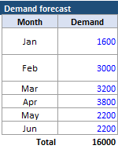

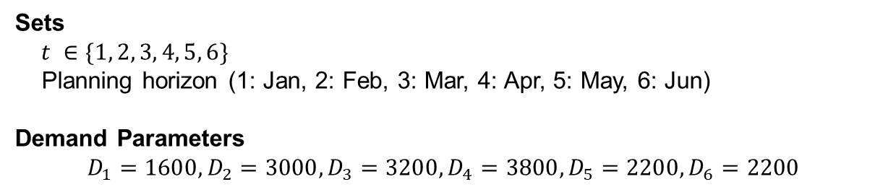
Demand Forecast at Red Tomato Tools
Sets
$t ∈\{1, 2, 3, 4, 5, 6\}$
Planning horizon (1: Jan, 2: Feb, 3: Mar, 4: Apr, 5: May, 6: Jun)
Demand Parameters
$$D_{1}=1600,D_{2}=3000,D_{3}=3200,D_{4}=3800,D_{5}=2200,D_{6}=2200$$
Highly seasonal demand
Capacity determined mainly by workforce size (i.e., flexible workforce)
Subcontracting, inventories, and backlogs are allowed
Minimizing cost is the same as maximizing profit (Why?)
Refer to provided xlsx file

Slide 2
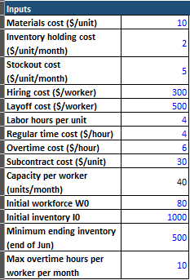
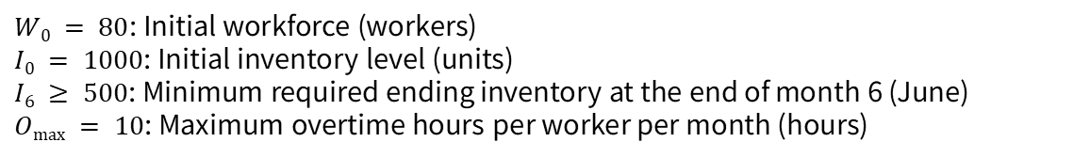
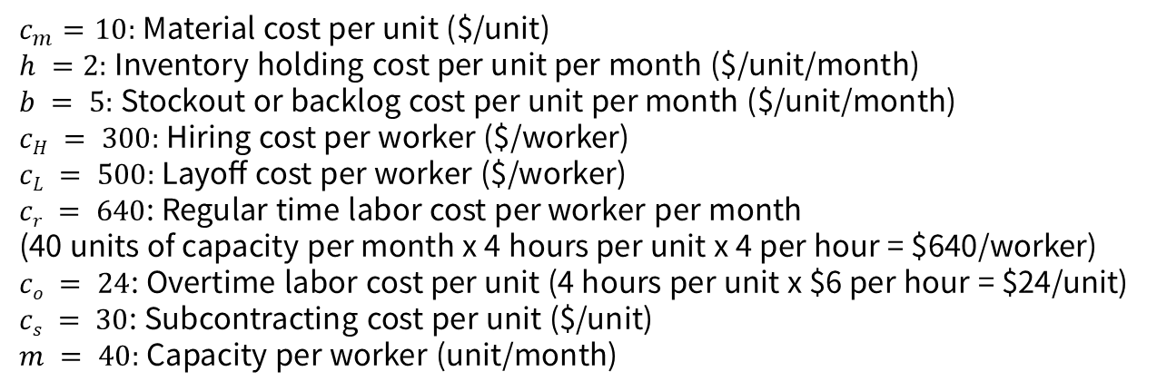
Input data for Red Tomato Tools
Cost Parameters
$c_{m}=10:$ Material cost per unit ($/unit)
$h =2:$Inventory holding cost per unit per month ($/unit/month)
$b = 5:$ Stockout or backlog cost per unit per month ($/unit/month)
$cH = 300:$Hiring cost per worker ($/worker)
$cL = 500:$Layoff cost per worker ($/worker)
$cr = 640$: Regular time labor cost per worker per month
(40 units of capacity per month x 4 hours per unit x 4 per hour = $640/worker)
$co = 24$: Overtime labor cost per unit (4 hours per unit x $6 per hour = $24/unit)
$cs = 30$: Subcontracting cost per unit ($/unit)
$m = 40:$Capacity per worker (unit/month)
Capacity and Initial States
$W0 = 80$: Initial workforce (workers)
$I0 = 1000$: Initial inventory level (units)
$I6 ≥ 500$: Minimum required ending inventory at the end of month 6 (June)
$Omax = 10$: Maximum overtime hours per worker per month (hours)
Refer to provided xlsx file

Slide 3
Decision variables
Decision variables
Decision variables
# of Workforce in period t | W_{t} | 640·W_{t}
Overtime hours in period t | O_{t} | 6·O_{t}
# of newly hired in period t | H_{t} | 300·H_{t}
# of layoff in period t | L_{t} | 500·L_{t}
# of Inventories in period t | I_{t} | 2·I_{t}
# of stocking out in period t | S_{t} | 5·S_{t}
# of production units in period t | P_{t} | 10·P_{t}
# of subcontract units in period t | C_{t} | 30·C_{t}
Refer to provided xlsx file

Slide 4
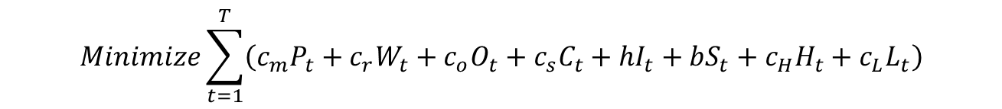
Linear programming model
$$Minimize\sum_{t=1}^{T}{\left(c_{m}P_{t}+c_{r}W_{t}+c_{o}O_{t}+c_{s}C_{t}+hI_{t}+bS_{t}+c_{H}H_{t}+c_{L}L_{t}\right)}$$
Minimization of the total cost
$$I_{t−1}−S_{t−1}+P_{t}=D_{t}+I_{t}−S_{t} ∀t$$
Inventory Balance Constraint
$$W_{t}=W_{t−1}+H_{t}−L_{t} ∀t$$
Workforce Balance Constraint
$$P_{t}≤m⋅W_{t}+\frac{O_{t}}{k} ∀t$$
Production Capacity Constraint
$$O_{t}≤O_{max}⋅W_{t} ∀t$$
$$I_{T}≥I_{min}$$
Ending Inventory Requirement

Slide 5

Linear programming model
$$Minimize\sum_{t=1}^{T}{\left(4800W_{t}+2000H_{t}+2500L_{t}+{20I}_{t}+80S_{t}\right)}$$
Minimization of the total cost
$$I_{t−1}−S_{t−1}+150W_{t}=D_{t}+I_{t}−S_{t} ∀t$$
Inventory Balance Constraint
$$I_{0}=500, S_{0}=0$$
$$W_{t}=W_{t−1}+H_{t}−L_{t} ∀t$$
Workforce Balance Constraint
$$W_{0}=0$$
$$P_{t}≤150W_{t} ∀t$$
Production Capacity Constraint

